Slide 1

Prediction of Chronic Kidney Disease Using Machine Learning
Sanjukktha S-124003277
Guided by:
Dr. Karthikeyan B
Senior Assistant Professor
Dept. of IT/SoC

Slide 2
BASE PAPER
Base Paper Title : Prediction of Chronic Kidney Disease - A Machine Learning Perspective
Journal Name : IEEE Access
Year of Publication : 2021
Author Names : Pankaj Chittora , Sandeep Chaurasia, Prasun Chakrabarti, Gaurav Kumawat, Tulika Chakrabarti, Zbigniew Leonowicz, Michał Jasiński, Łukasz Jasiński , Radomir Gono , Elżbieta Jasińska And Vadim Bolshev
Base Paper Link : https://ieeexplore.ieee.org/document/9333572

Slide 3
INTRODUCTION
Chronic Kidney Disease(CKD) is a common worldwide disease where the kidneys are damaged and unable to filter waste from the blood to produce urine, resulting in waste buildup in the body.
CKD is chronic and can develop gradually over time due to several causes, including diabetes, high blood pressure, and heart disease.
Diabetes and high blood pressure are the two primary diseases associated with CKD, and controlling these conditions is essential in preventing CKD.
CKD can go unnoticed until severe kidney damage occurs. Hospitalization rates for CKD are increasing annually, but the global mortality rate remains constant.
Diagnostic tests, including estimated glomerular filtration rate (eGFR), urine tests, and blood pressure readings

Slide 4
PROBLEM STATEMENT
Using machine learning classifiers enables timely disease detection. Chronic Kidney Disease prediction was performed using a dataset from the UCI repository.
To improve accuracy, various algorithms including K-Nearest Neighbor (KNN), Logistic Regression, Random Forest and Decision Tree were implemented.
Feature selection techniques were applied and results were computed for each classifier using different methods.

Slide 5
LITERATURE SURVEY
Paper | Accuracy | Limitations
In 2015 Parul et al. conducted a Comparative Study for predicting CKD by using classification algorithms K-Nearest Neighbour and SVM | 78.75% | Accuracy is low. Room to improve the accuracy.
Torgyn Shaikhina et al. in 2017 developed classification model for outcome prediction in antibody incompatible kidney transplantation. | 85% | Accuracy is low. Room to improve the accuracy. Based on many unrelated attributes that it led to many contingencies.
In 2017 Gunarathne et al. has made a Performance Evaluation on Machine Learning Classification Techniques for Disease Forecasting and classification through Data Analytics for Chronic Kidney Disease (CKD) | 89% | Naïve Bayes with OneR attribute Selector was used for prediction CKD status of a patient. The idea was to select a subset from input data by elimination idle data which carried little or no predictive knowledge. This led to many contingencies.
Dr.Uma N Dulhare et al. in 2016 performed Extraction of action Rules for Chronic Kidney Disease Prediction using Naïve Bayes | 85.3% | Accuracy is low. No feature selection methods were used. Leading to use all 24 attributes for the prediction.

Slide 6
DATA SET
The data set used in this project is called the UCI (University Of California, Irvine) dataset and it has been obtained from UCI website.
This dataset contains 400 instances and 24 attributes with 1 target attribute.
The target attribute has labelled in two-class to represent CKD or non-CKD.
The dataset was collected from various hospitals in 2015.

Slide 7
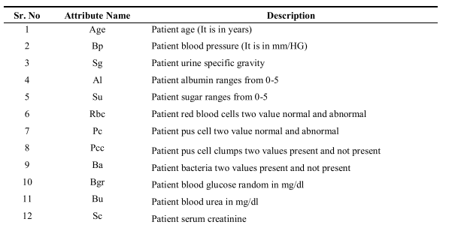
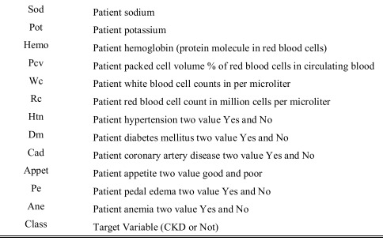
ATTRIBUTE LIST

Slide 8
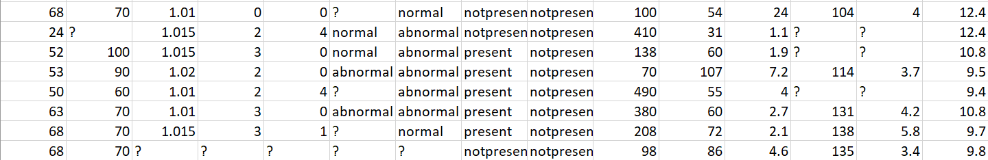
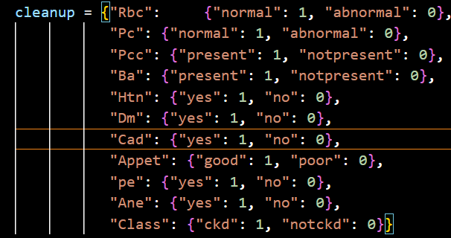

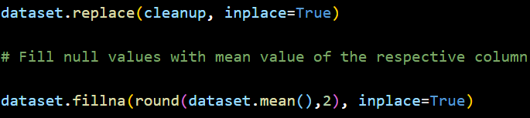
DATA PRE-PROCESSING
The raw data as seen above, contains many empty entries represented by “?”.
Furthermore, there are entries represented by nominal values such as “normal”, ”abnormal” etc.
Hence Data Pre-Processing is required.
All nominal values are replaced with binary values as shown in the code snippet below.
The empty entries are replaced with the corresponding attribute’s mean value.

Slide 9
FEATURE SELECTION
Feature selection is the process of selecting the most relevant variables or features for use in model building. Feature selection can help to improve model accuracy, reduce overfitting, and save time and computational resources.
Feature selection methods:
Filter methods: Select features based on statistical measures such as correlation or mutual information.
Wrapper methods: Use a model to evaluate the performance of different feature subsets.
Embedded methods: Incorporate feature selection into the model-building process. The most common method is the Lasso method

Slide 10
CORRELATION-BASED FEATURE SELECTION
Correlation-based feature selection is a technique used in machine learning and data analysis to identify the most relevant features in a dataset. It works by calculating the correlation between each feature and the target variable, and selecting the features that have the highest correlation. The idea behind this technique is that features with high correlation to the target variable are more likely to be useful in making accurate predictions.
The correlation can be measured using different metrics and in this paper, Pearson's correlation coefficient is used. Once the correlation between each feature and the target variable is calculated, a threshold is set to select the most important features.
The results found after applying CFS on the dataset, 6 attributes were picked to be the most important features and the rest were dropped.
Hemo, Sc, Bgr, Pc, Al and Bu were the selected attributes.

Slide 11
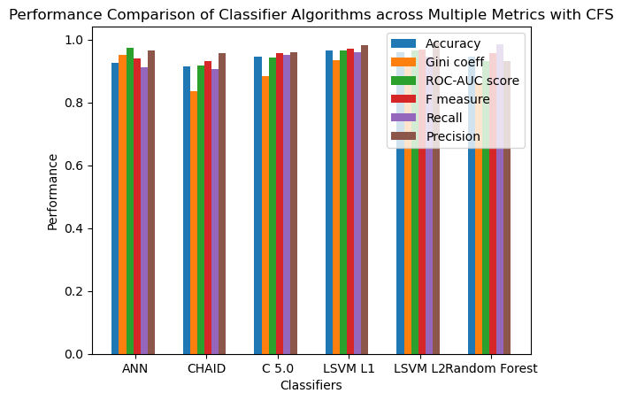
Accuracy, ROC-AUC Score, F measure, Recall, Precision are reduced to 0-1 Scale

Slide 12
WRAPPER METHOD
Wrapper method is a feature selection technique that involves training a machine learning model on different subsets of input features. The idea behind the wrapper method is to evaluate the performance of a model with different subsets of features and select the subset that provides the best performance. Forward feature selection wrapper method is used.
Advantages: Can handle complex interactions between features, can improve model accuracy.
Limitations: Computationally expensive, prone to overfitting.
The results found after applying Wrapper method on the dataset, 6 attributes were picked to be the most important features and the rest were dropped.
'Sg', 'Pcc', 'Ba', 'Hemo', 'Htn', 'Cad'were the selected attributes.

Slide 13
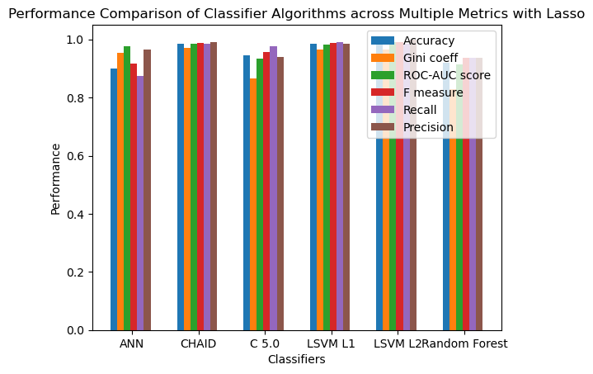
Accuracy, ROC-AUC Score, F measure, Recall, Precision are reduced to 0-1 Scale

Slide 14
LASSO METHOD
Lasso method is a feature selection technique that uses regularization to shrink the coefficients of input features towards zero. The idea behind the Lasso method is to penalize the model for using too many input features, which can help prevent overfitting.
The Lasso method works by adding a penalty term to the loss function of a linear regression model. The penalty term is proportional to the absolute value of the coefficients of the input features, which encourages the coefficients to be exactly zero for certain features. The Lasso method is able to perform both feature selection and feature shrinkage at the same time.
The results found after applying Wrapper method on the dataset, 13 attributes were picked to be the most important features and the rest were dropped.
Sg, Al, Su, Rbc, Bgr, Sc, Sod, Hemo, Pcv, Htn, Dm, Appet, pe were the selected attributes.

Slide 15
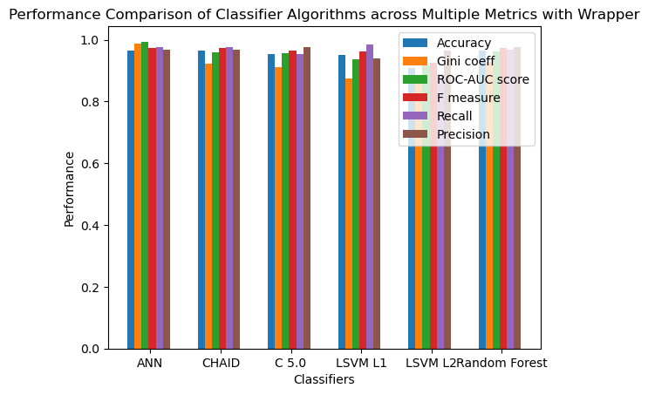

Slide 16
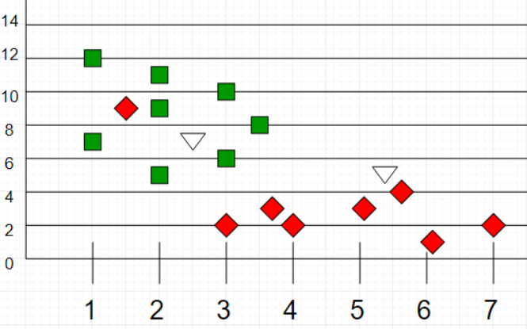
K-NEAREST NEIGHBOUR
K-Nearest Neighbors is one of the most basic yet essential classification algorithms in Machine Learning.
It belongs to the supervised learning domain and finds intense application in pattern recognition, data mining and intrusion detection.
It is widely disposable in real-life scenarios since it is non-parametric, meaning, it does not make any underlying assumptions about the distribution of data (as opposed to other algorithms such as GMM, which assume a Gaussian distribution of the given data).
We are given some prior data (also called training data), which classifies coordinates into groups identified by an attribute.

Slide 17
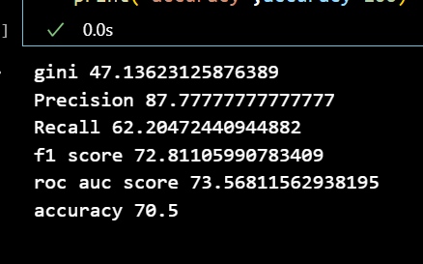
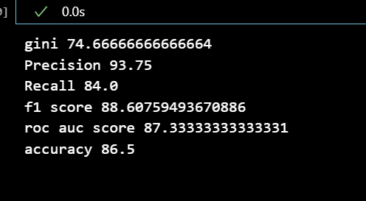
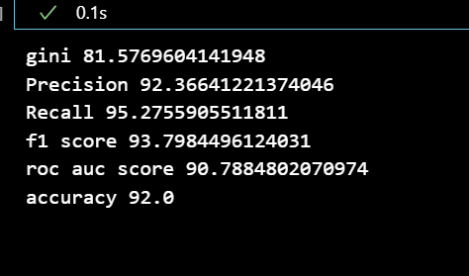
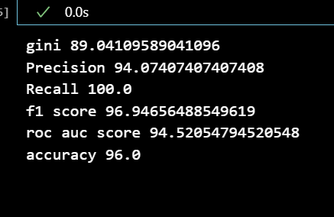
KNN WITH FULL FEATURES KNN WITH CFS
ANN WITH LASSO ANN WITH WRAPPER

Slide 18
ARTIFICIAL NEURAL NETWORK
ANN stands for Artificial Neural Network. It is a type of machine learning model inspired by the structure and function of the biological nervous system.
The basic building block of an ANN is the artificial neuron, which takes input signals, processes them, and produces an output signal. The neurons are organized in layers, and connections between them are adjusted during the training process to optimize the model's performance.
ANNs can be used for a variety of tasks, such as classification, regression, and pattern recognition. They are widely used in areas such as computer vision, natural language processing, and speech recognition.

Slide 19
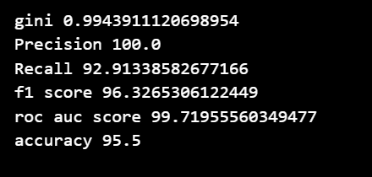
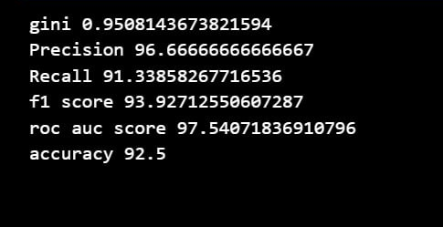
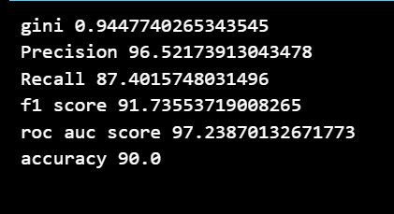
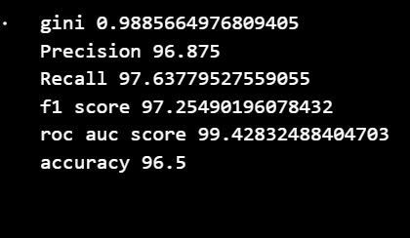
ANN WITH FULL FEATURES ANN WITH CFS
ANN WITH LASSO ANN WITH WRAPPER

Slide 20
RANDOM FOREST
Random forest is a supervised machine learning algorithm that builds a collection of decision trees and aggregates their predictions to make a final prediction.
Each decision tree is constructed by randomly selecting a subset of the features and a subset of the data. The tree is grown by recursively splitting the data based on the selected feature that best separates the data. The process continues until a stopping criterion is met, such as reaching a maximum tree depth or having a minimum number of samples in each leaf node.
To make a prediction, the random forest algorithm aggregates the predictions of all the decision trees in the collection. Each tree's prediction is weighted equally, and the final prediction is determined by majority voting.

Slide 21
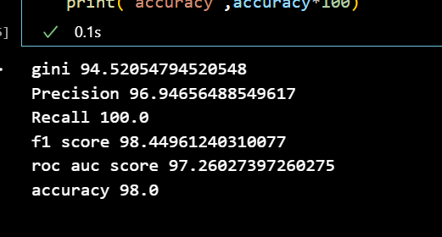
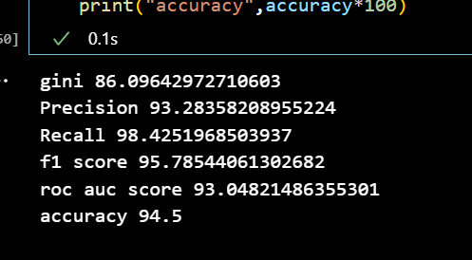
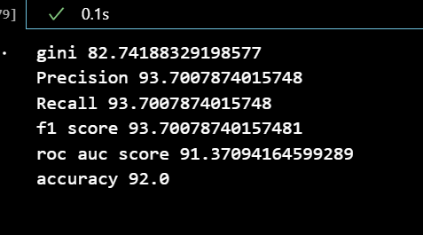
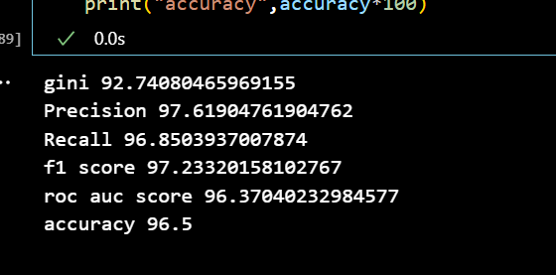
RANDOM FOREST WITH FULL FEATURES RANDOM FOREST WITH CFS
RANDOM FOREST WITH LASSO RANDOM FOREST WITH WRAPPER

Slide 22
LINEAR SUPPORT VECTOR MACHINES (L1 PENALTY)
Linear Support Vector Machines (LSVM) with L1 penalty, also known as Lasso SVM, is a linear classifier that uses the L1 regularization penalty on the SVM cost function. The L1 penalty imposes a constraint on the sum of the absolute values of the model parameters, which leads to sparse solutions where many of the features have zero coefficients.
In other words, LSVM L1 penalty encourages the model to select only the most important features while reducing the impact of irrelevant features. This can be useful for feature selection or when dealing with high-dimensional datasets where only a few features are relevant. Additionally, the sparsity of the solution can lead to faster training and better interpretability of the model.

Slide 23
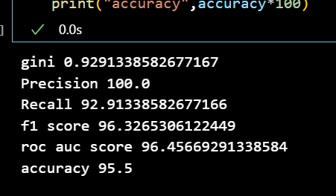
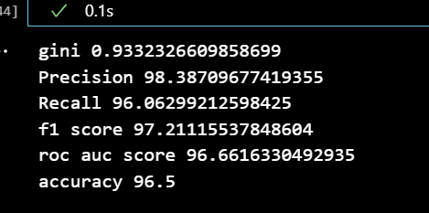
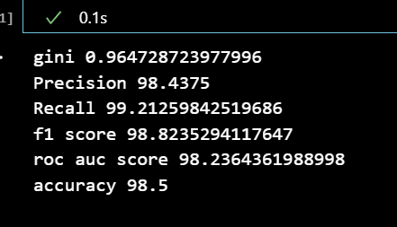
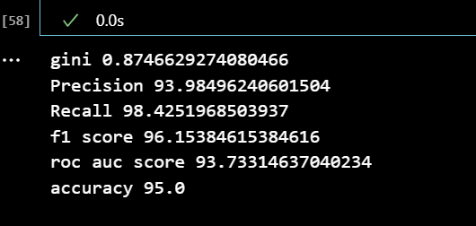
LSVM L1 WITH FULL FEATURES LSVM L1 WITH CFS
LSVM L1 WITH LASSO LSVM L1 WITH WRAPPER

Slide 24
LINEAR SUPPORT VECTOR MACHINES (L2 PENALTY)
LSVM stands for Linear Support Vector Machine, which is a popular algorithm used for classification tasks in machine learning. L2 penalty, also known as ridge regression or L2 regularization, is a technique used to prevent overfitting in models by adding a penalty term to the loss function.
In the context of LSVM, the L2 penalty is added to the objective function, which aims to find the hyperplane that maximizes the margin between the classes while minimizing the classification error. The L2 penalty term adds a penalty to the objective function proportional to the square of the magnitude of the weights, which encourages the model to have smaller weight values and thus avoid overfitting.

Slide 25
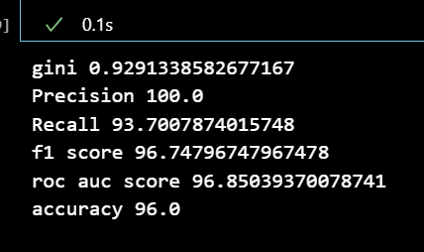
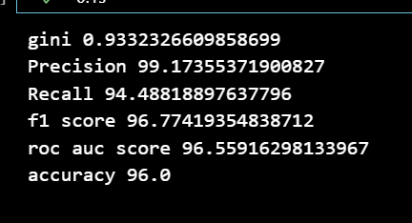
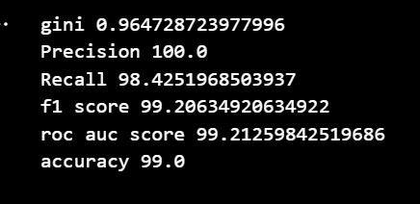
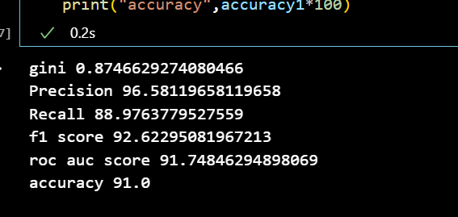
LSVM L2 WITH FULL FEATURES LSVM L2 WITH CFS
LSVM L2 WITH LASSO LSVM L2 WITH WRAPPER

Slide 26
CHAID
CHAID (Chi-squared Automatic Interaction Detection) is a decision tree algorithm that is used for categorical data analysis in machine learning. It is a non-parametric statistical technique that can handle both nominal and ordinal data types.
The CHAID algorithm works by recursively splitting the data into smaller and smaller groups, based on the strongest associations between the target variable and the predictor variables. These splits are chosen based on the chi-squared test, which measures the degree of association between categorical variables.

Slide 27
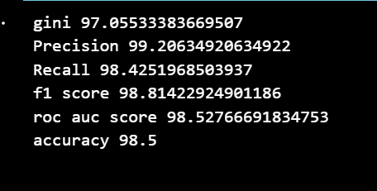
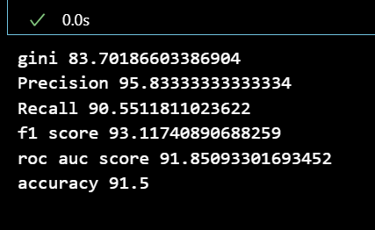
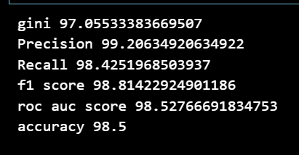
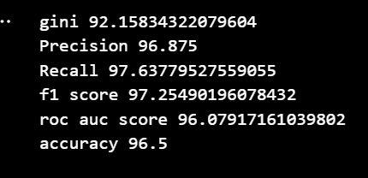
CHAID WITH FULL FEATURES CHAID WITH CFS
CHAID WITH LASSO CHAID WITH WRAPPER

Slide 28
C5.0
C5.0 is a decision tree algorithm used for classification tasks in machine learning. It is an improvement over the earlier C4.5 algorithm and was developed by Ross Quinlan. C5.0 is a popular algorithm because it is efficient, scalable, and produces highly accurate models.
The C5.0 algorithm works by recursively partitioning the data into smaller and smaller subsets based on the predictor variables that provide the most information gain or decrease in impurity in the target variable. It uses a combination of entropy and gain ratio measures to determine the best split at each node in the tree.
One of the key features of C5.0 is its ability to handle both categorical and continuous predictor variables. It also has a built-in mechanism for handling missing data, which is common in real-world datasets.

Slide 29
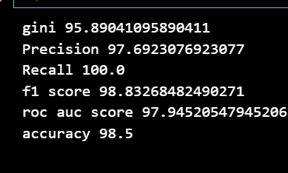
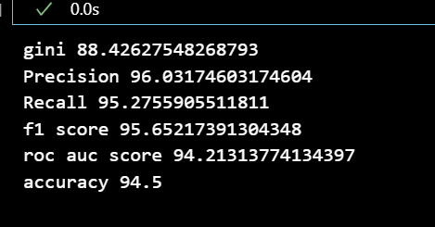
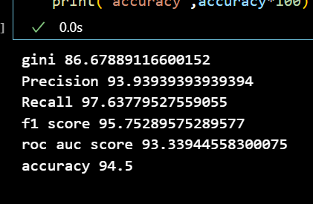
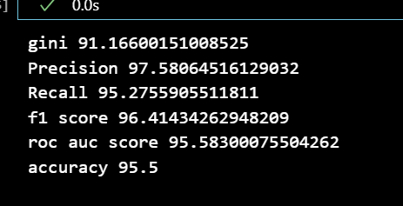
C5.0 WITH FULL FEATURES C5.0 WITH CFS
C5.0 WITH LASSO C5.0 WITH WRAPPER

Slide 30
LOGISTIC REGRESSION
Logistic Regression is a statistical model used in machine learning to predict binary or categorical outcomes. It is a type of supervised learning algorithm that models the relationship between a dependent variable and one or more independent variables by estimating the probability of a binary outcome.
The model works by calculating the odds of the outcome and then transforming these odds into a probability using a sigmoid function. The resulting probability is used to classify new instances into one of the two classes. The algorithm uses maximum likelihood estimation to find the parameters that best fit the data.

Slide 31
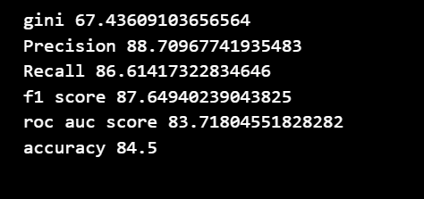
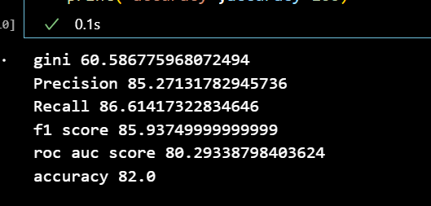
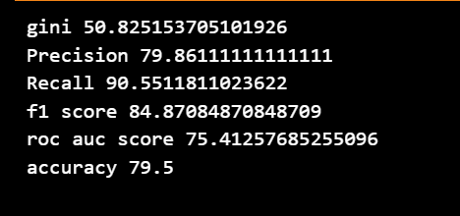
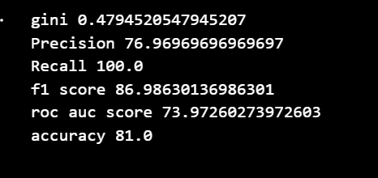
LOGISTIC REGRESSION WITH FULL FEATURES LOGISTIC REGRESSION WITH CFS
LOGISTIC REGRESSION WITH LASSO LOGISTIC REGRESSION WITH WRAPPER

Slide 32
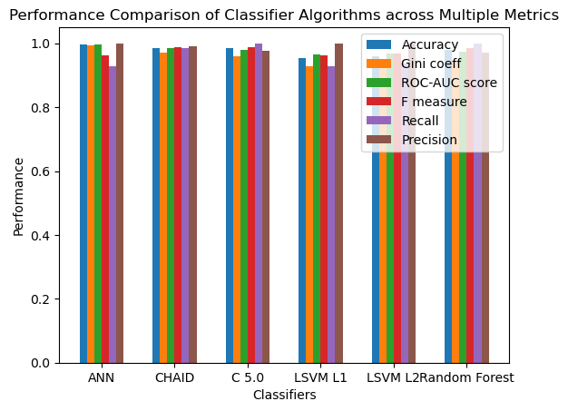
COMPARISON OF ALL MODELS BASED ON THEIR MEASURES
Accuracy, ROC-AUC Score, F measure, Recall, Precision are reduced to 0-1 Scale

Slide 33
SMOTE
SMOTE (Synthetic Minority Over-sampling Technique) is a method used in data mining and machine learning to address class imbalance. It involves synthesizing new instances in the minority class by interpolating between existing instances. The SMOTE algorithm works by selecting a random minority class instance and computing its k nearest neighbors. Then, it selects one of those neighbors and creates a new synthetic instance by interpolating between the selected neighbor and the original instance. By repeating this process, the minority class is over-sampled, resulting in a more balanced dataset. SMOTE can improve the performance of machine learning models by reducing bias towards the majority class and increasing the accuracy of the minority class predictions.

Slide 34
Disadvantages of SMOTE
Overfitting: SMOTE can create synthetic examples that are too similar to the original minority class examples, which may lead to overfitting and poor generalization to new data.
Loss of information: SMOTE may not capture the full range of variability in the minority class, leading to a loss of information and potentially degrading the performance of the model.
Bias towards the majority class: In some cases, SMOTE may generate synthetic examples that are more similar to the majority class, leading to a bias towards that class.
Random State: SMOTE may generate different ranging values for different random states and therefore be a cause of ambiguity.

Slide 35
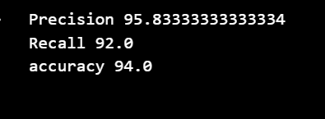
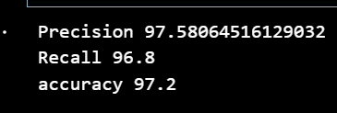
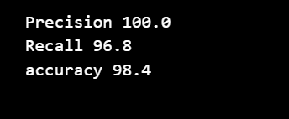
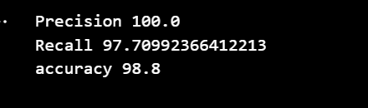
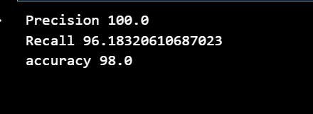
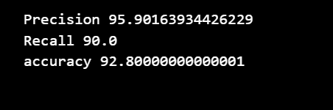
ANN WITH SMOTE CHAID WITH SMOTE C5.0 WITH SMOTE
LSVM L1 WITH SMOTE LSVM L1 WITH SMOTE RANDOM FOREST WITH SMOTE

Slide 36
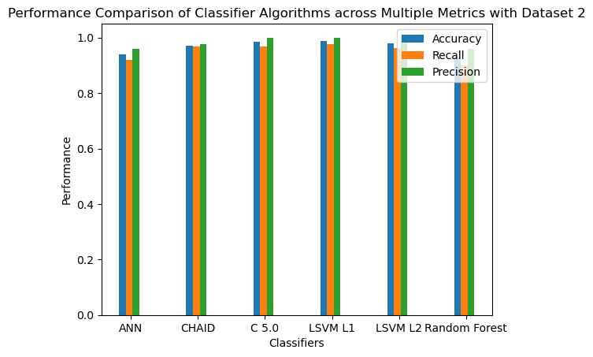

Slide 37
REFERENCES
https://archive.ics.uci.edu/ml/datasets/chronic_kidney_disease
https://www.ijert.org/research/comparative-study-of-chronic-kidney-disease-prediction-using-knn-and-svm-IJERTV4IS120622.pdf
https://www.semanticscholar.org/paper/Chronic-Kidney-Disease-Prediction-on-Imbalanced-by-Yildirim/0bfbafc8d7fbfada667261d4987841cc6c7f4677

